Slide 1

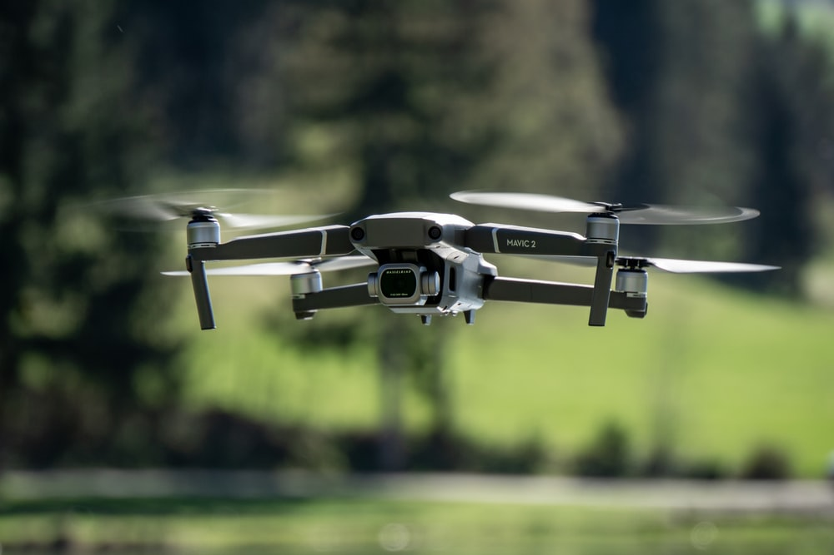
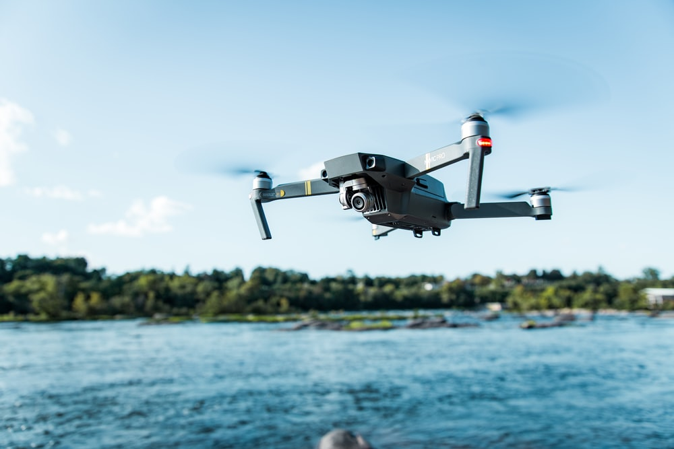

Countering Drones
Jonathan Devaux
Student Reg: 1603905

Slide 2

Aims
Review methods for drone countering
Measure 2.4 and 5.8GHz signals as drones operate within the 2 frequencies
Perform experiments
Develop a potential solution
What next

Slide 3
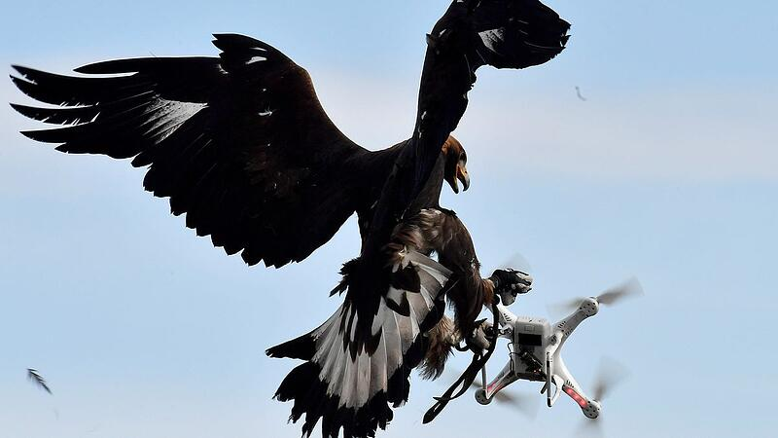
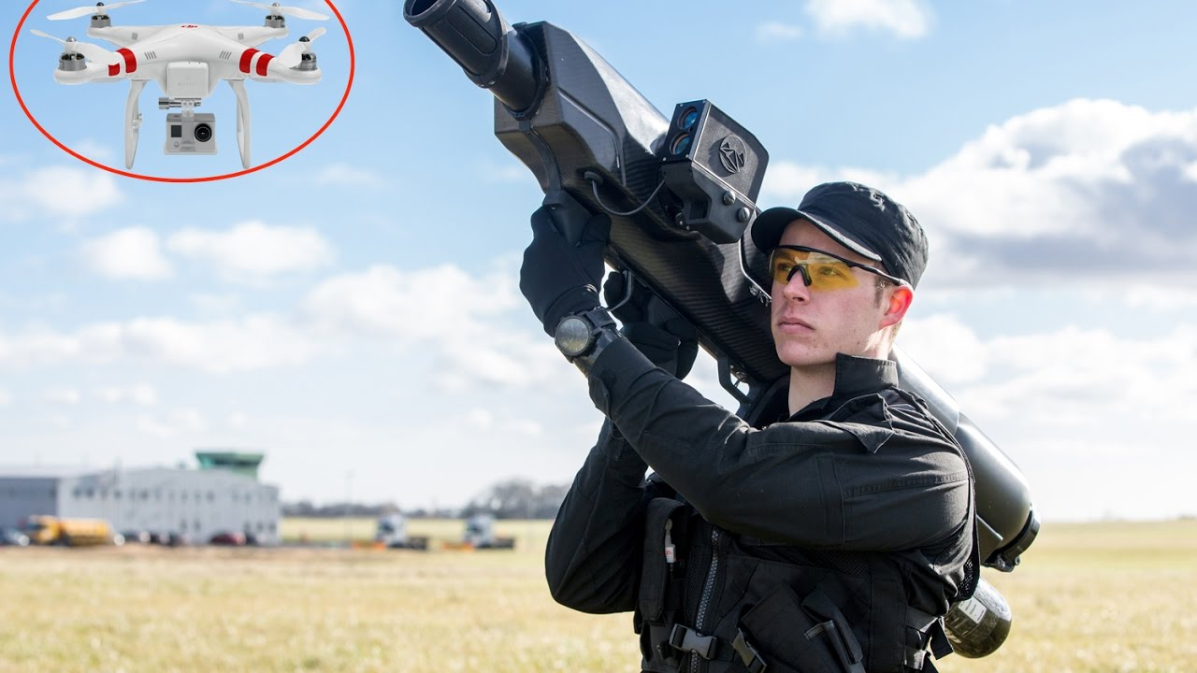
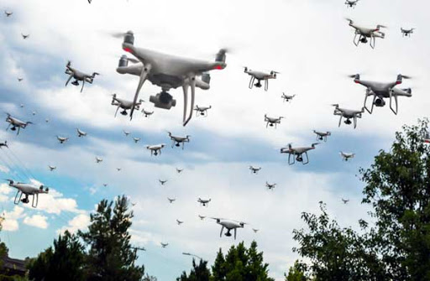
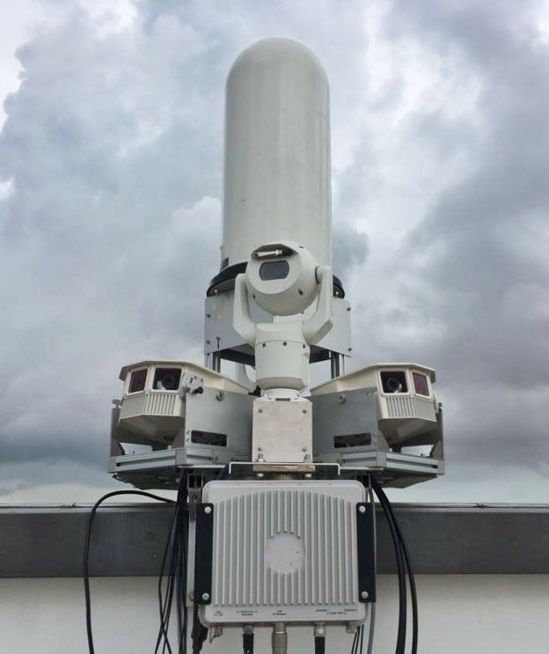
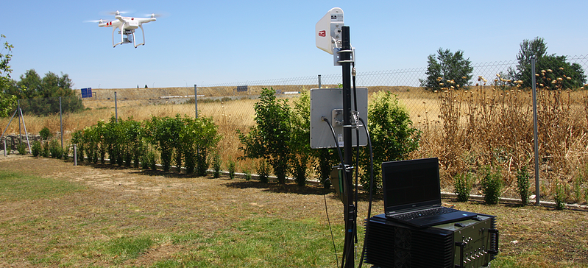
Countering drone methods
GPS spoofing
RF jamming
Defence drone swarm
Birds of prey
Nets/net gun
Early warning system

Slide 4
Experiments summary in order
2.4GHz testing – Flat
Software defined radio (SDR)
5GHz testing
2.4GHz testing
5GHz outdoor testing
2.4GHz outdoor testing
Body block method 2.4GHz outdoor testing
Body block method 5GHz indoor testing

Slide 5
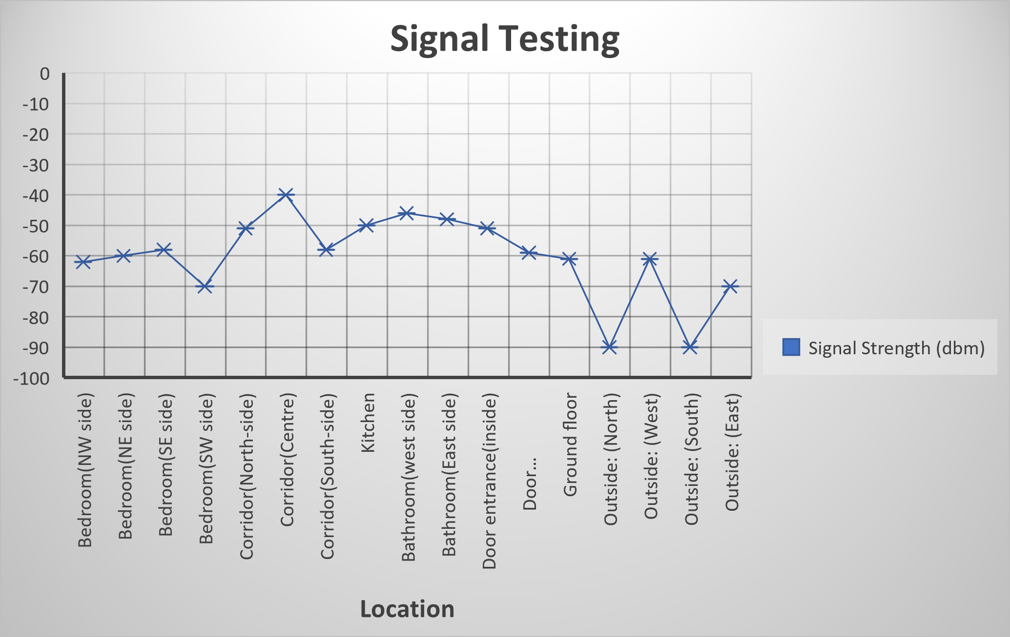
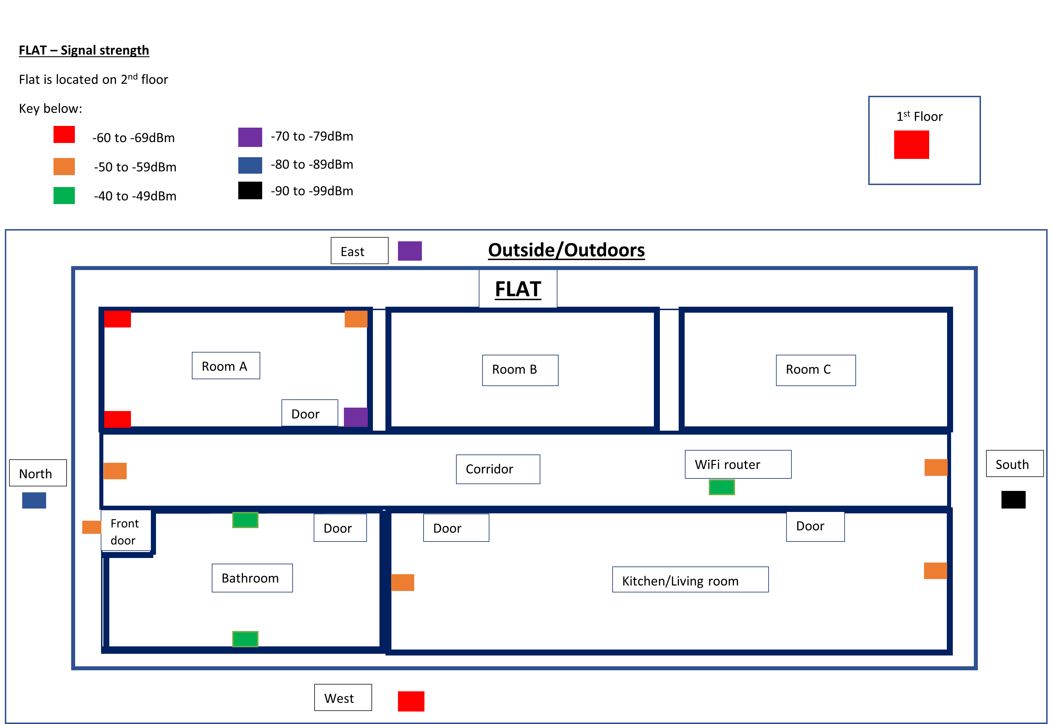
Experiment 1
2.4GHz testing – Flat
Mobile device with WiFi signal strength apps used
Signal stronger when device is closer to the HUB
Results table
Graph
Test area diagram
Diagram

Slide 6
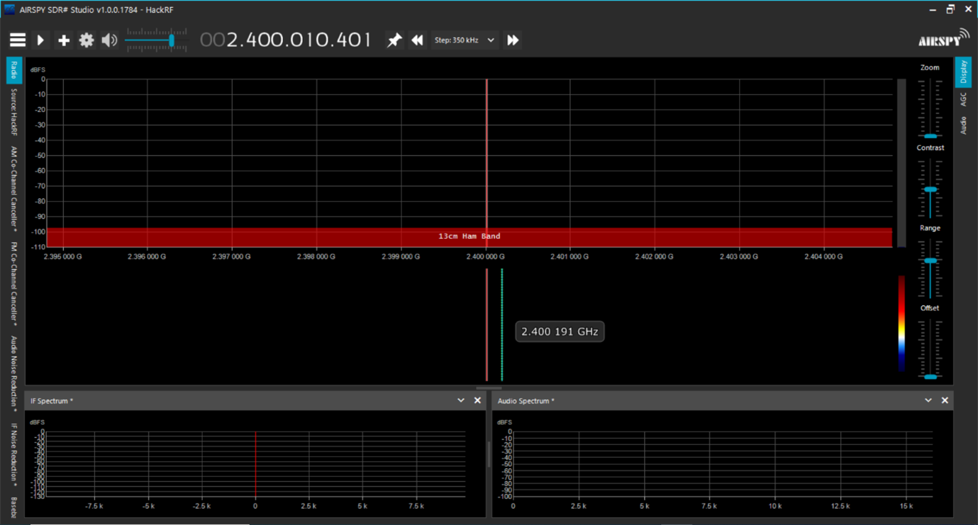
Experiment 2
SDR testing for 2.4GHz
13cm Ham band detected
Software SDR sharp used

Slide 7
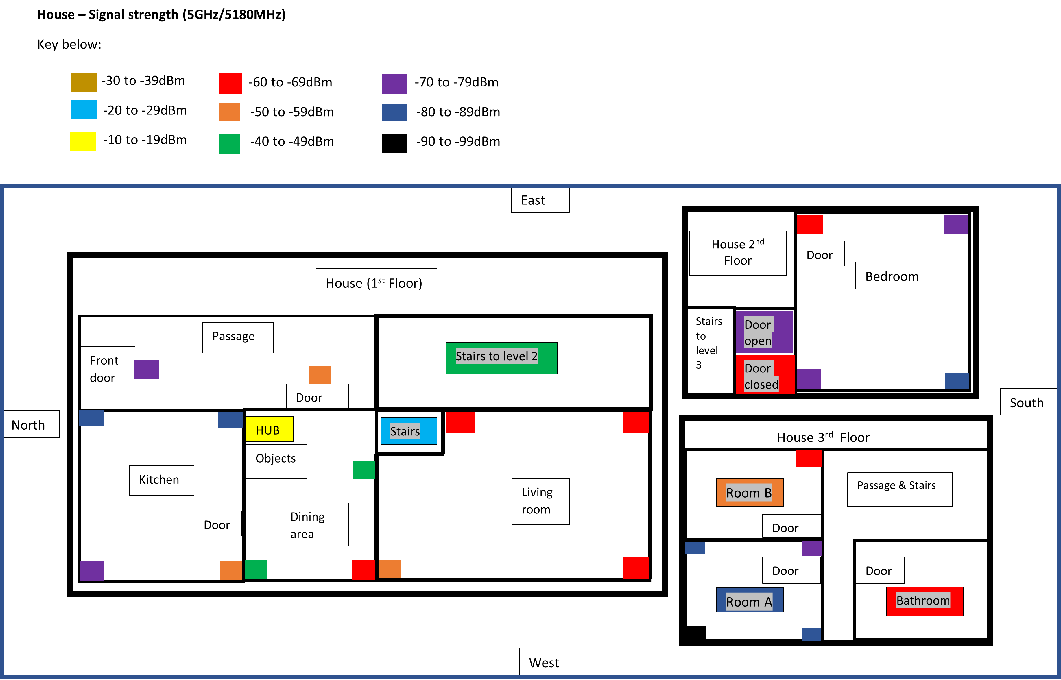
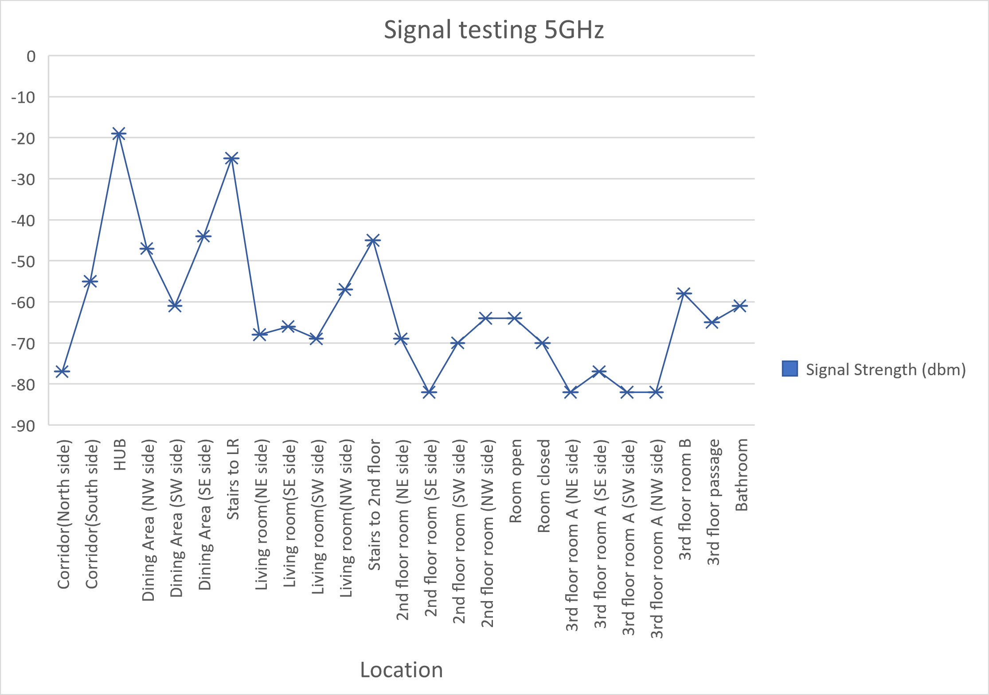
Experiment 3
5 GHz indoors testing
Testing inside house
Each square block represents each floor in the house

Slide 8
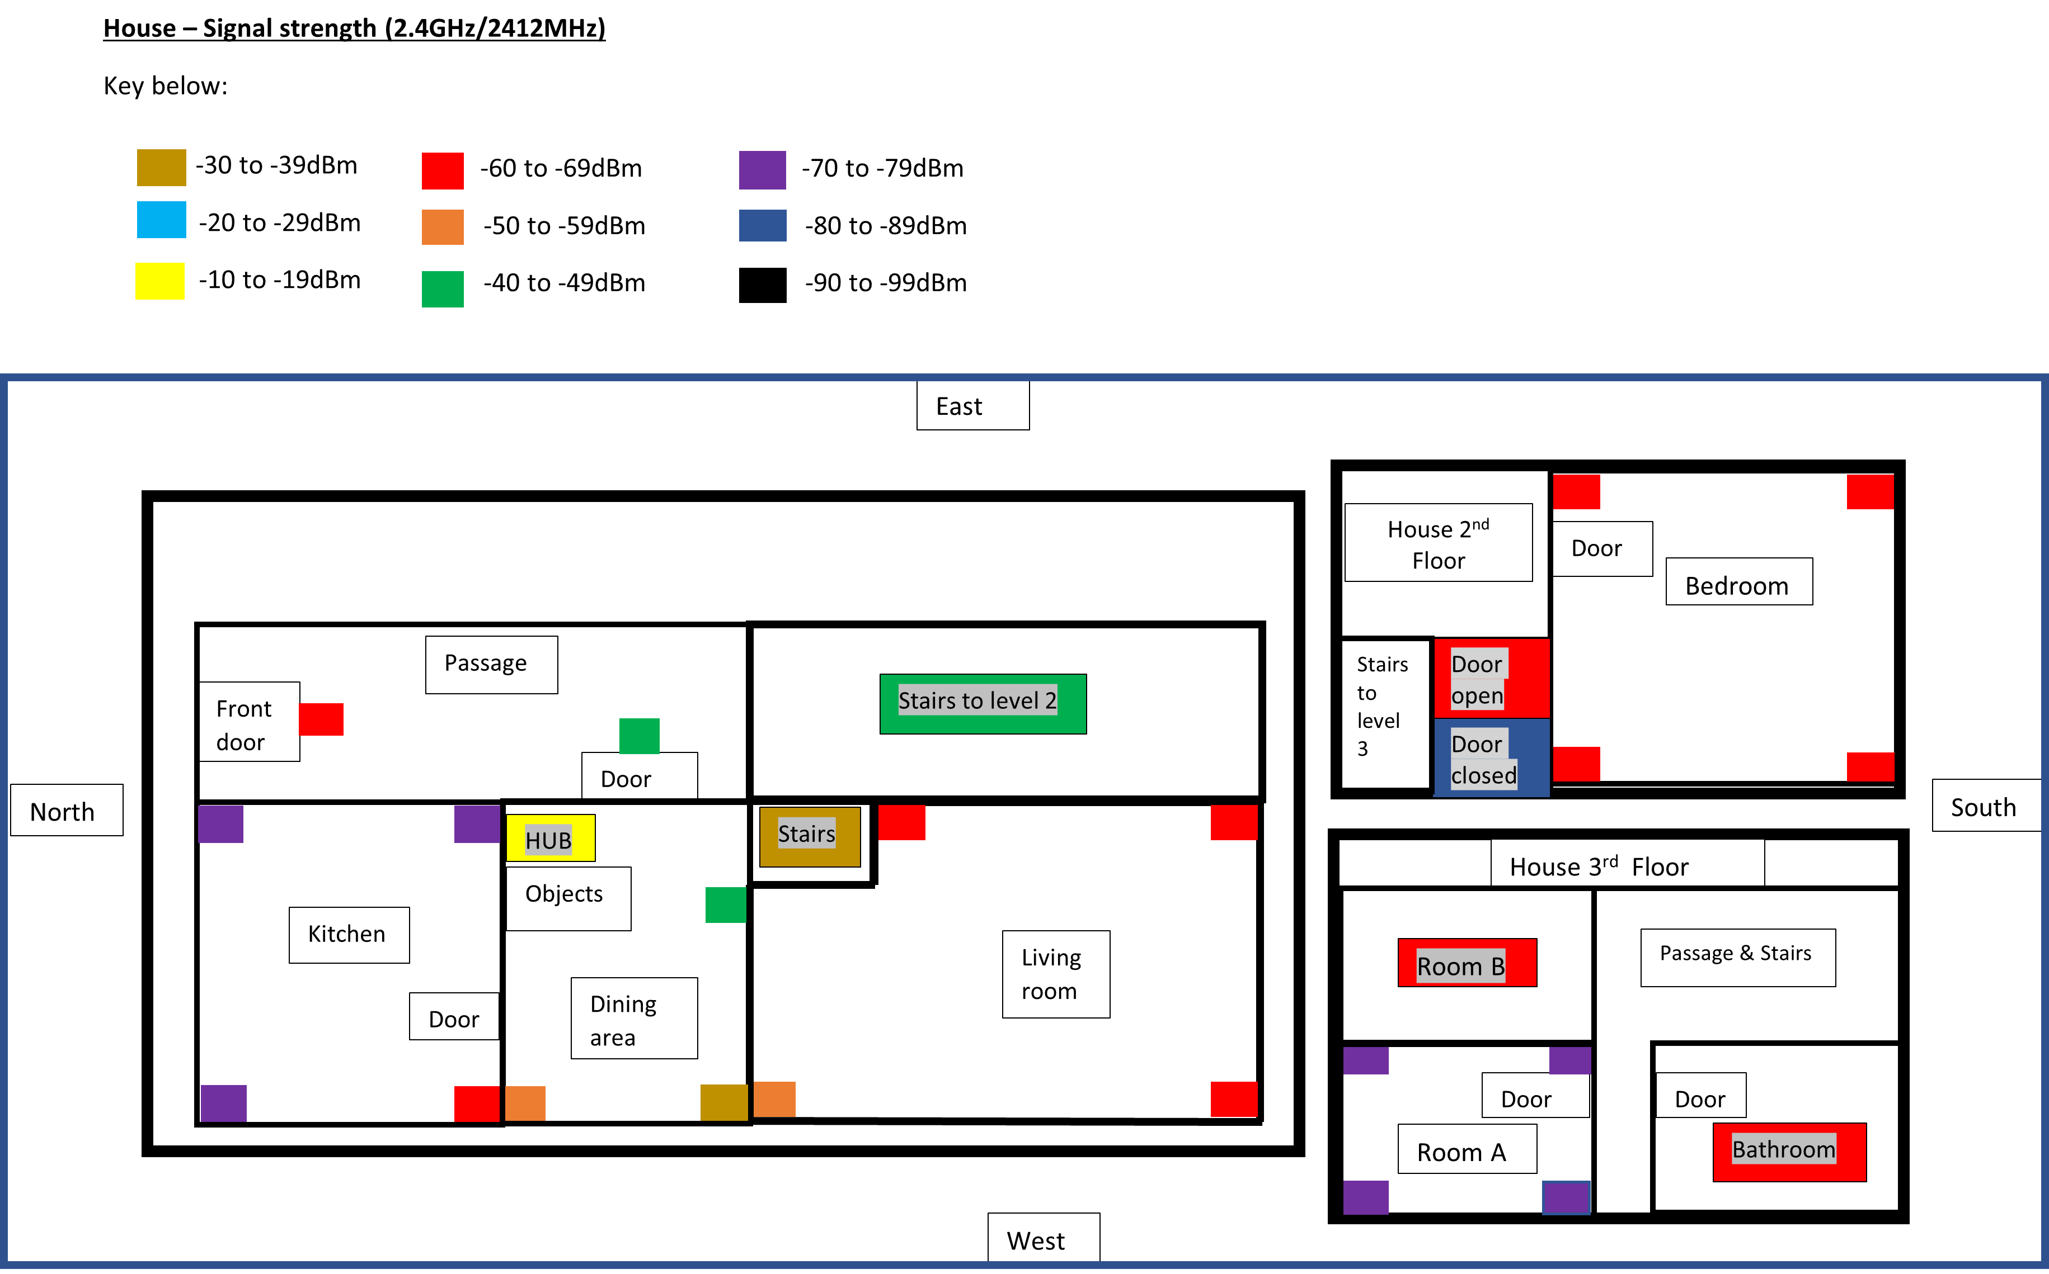
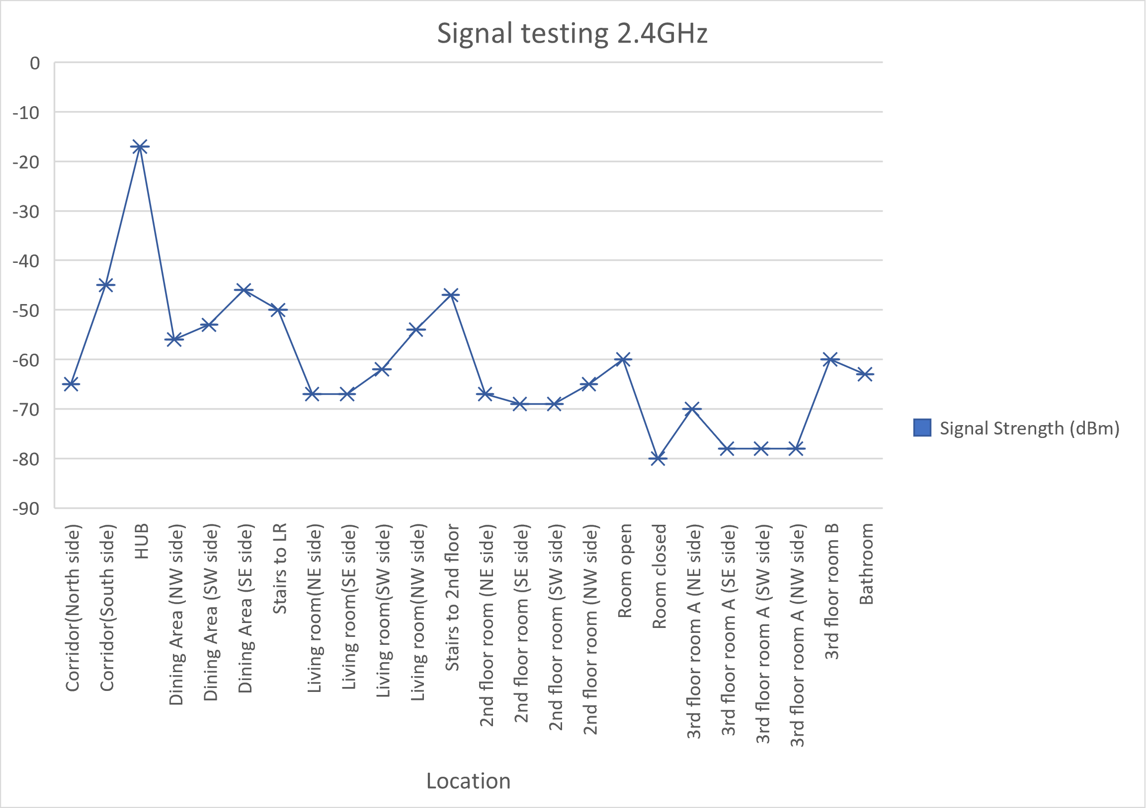
Experiment 4
2.4GHz indoors testing
Similar to the experiment 3 but instead 2.4GHz testing
2.4GHz has more signal range

Slide 9
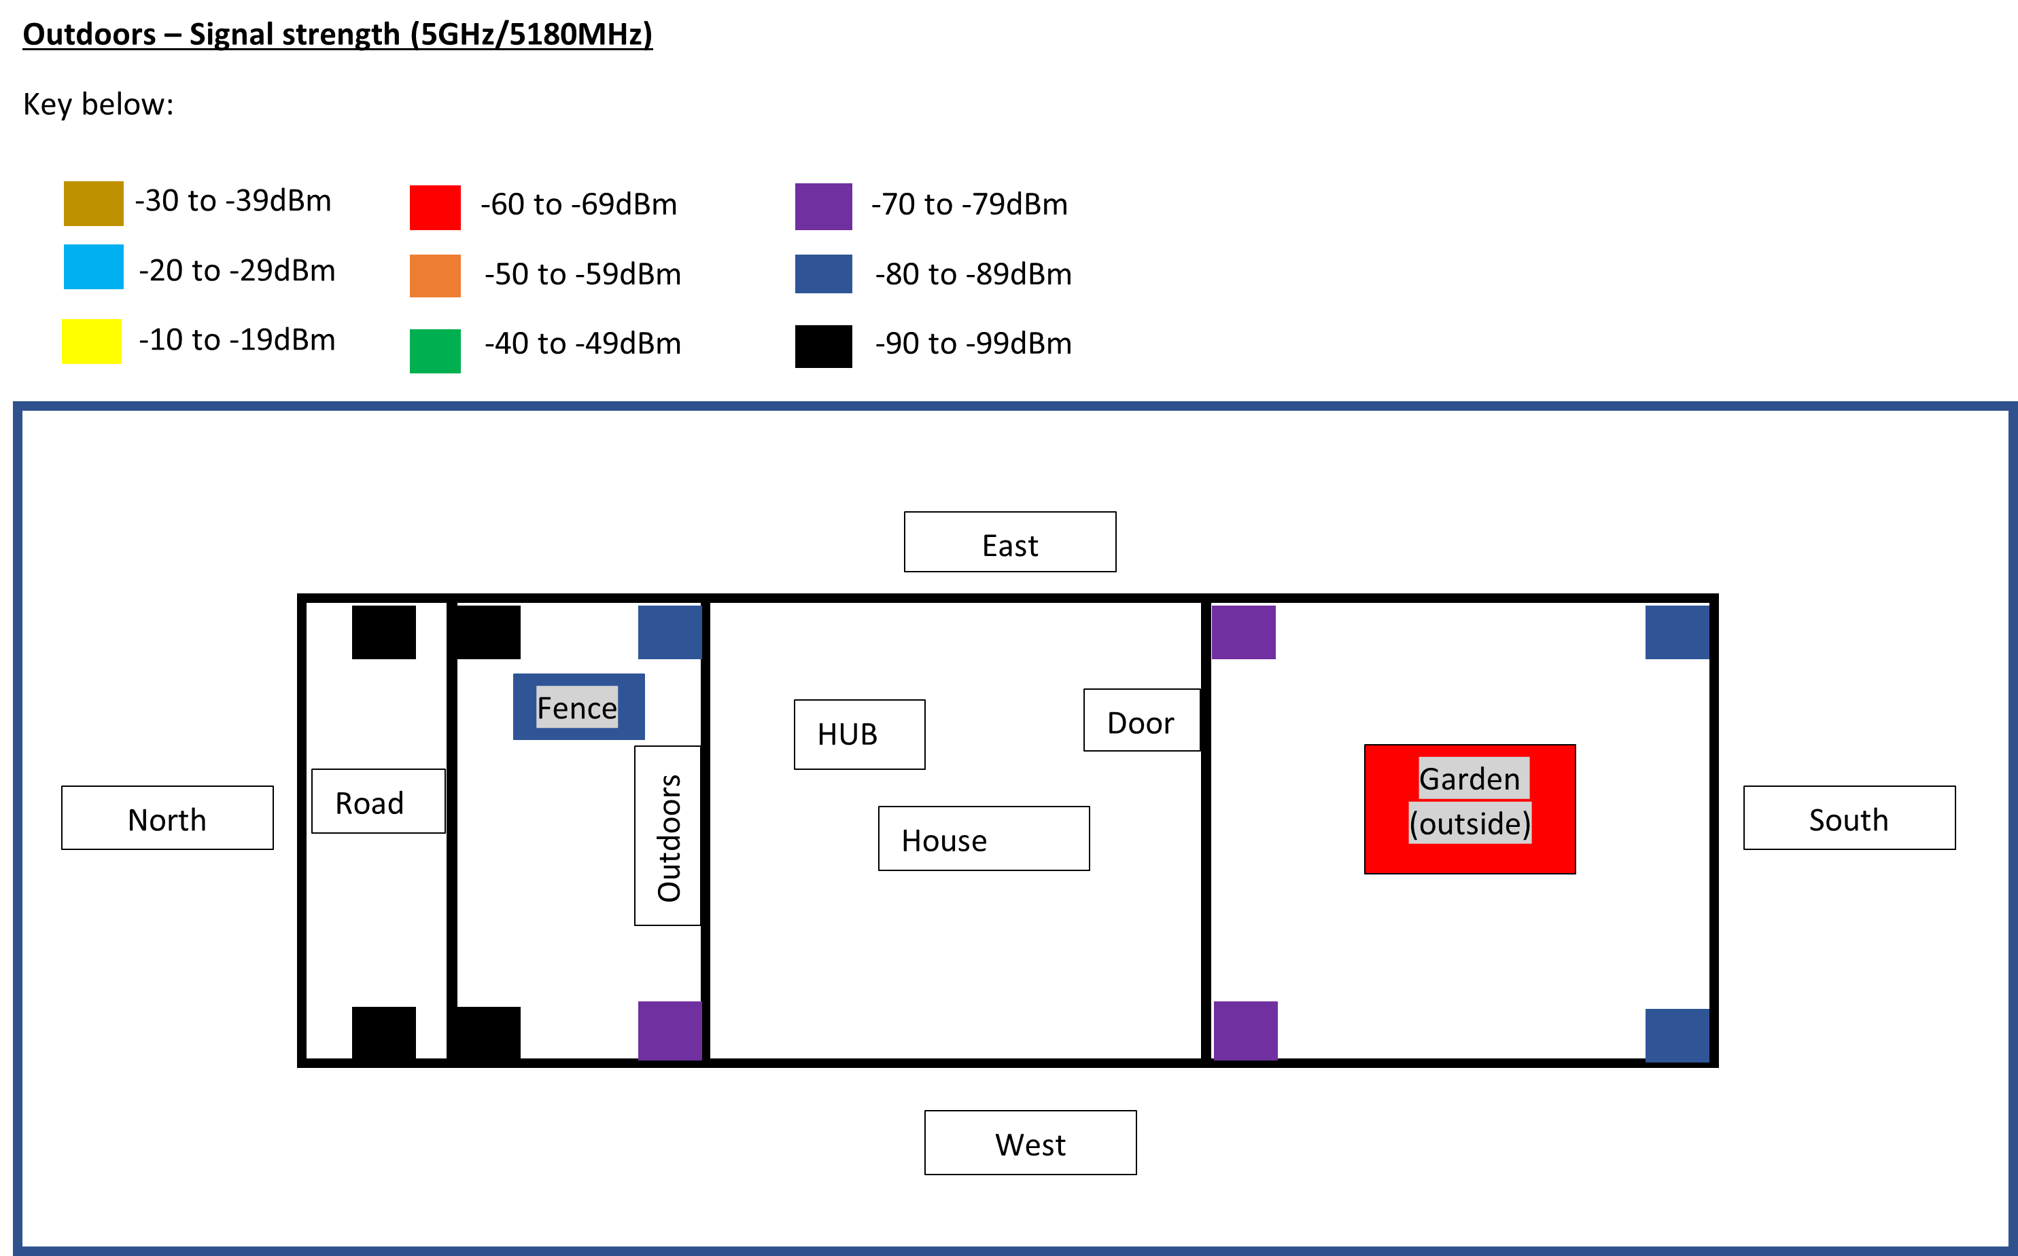
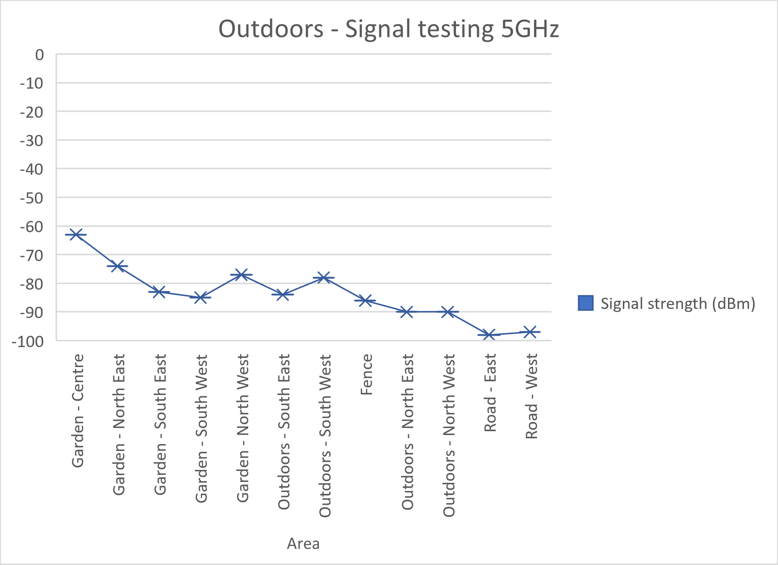
Experiment 5
5GHz Outdoors testing
Signal strength generally weaker

Slide 10
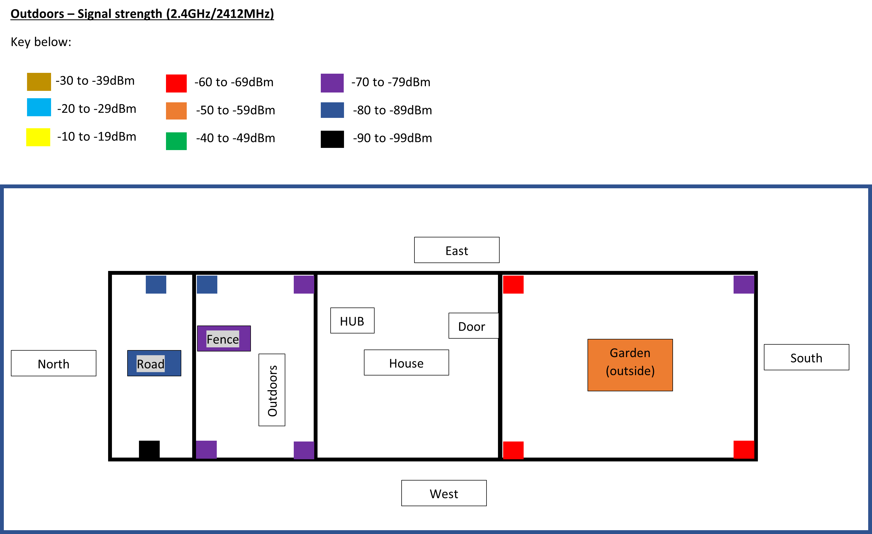
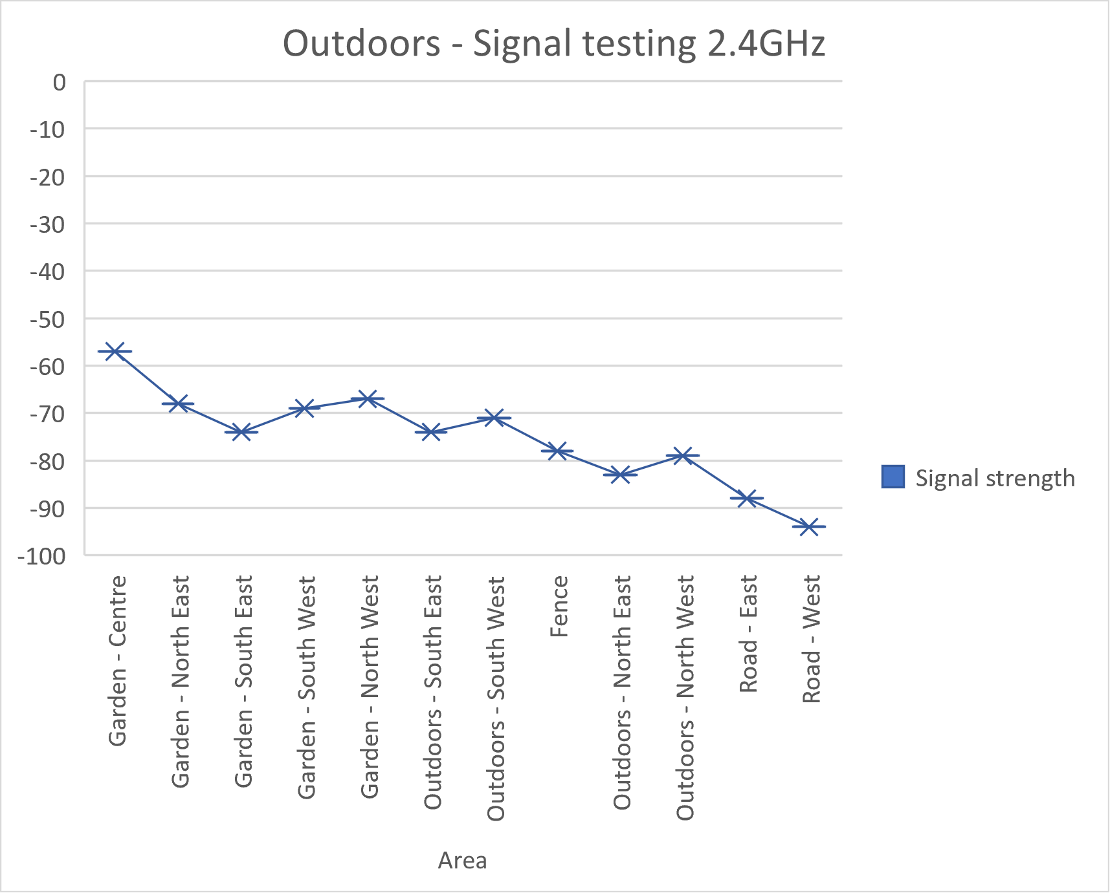
Experiment 6
2.4GHz outdoors testing
More range compared to experiment 5
Signal strength gradually declined

Slide 11
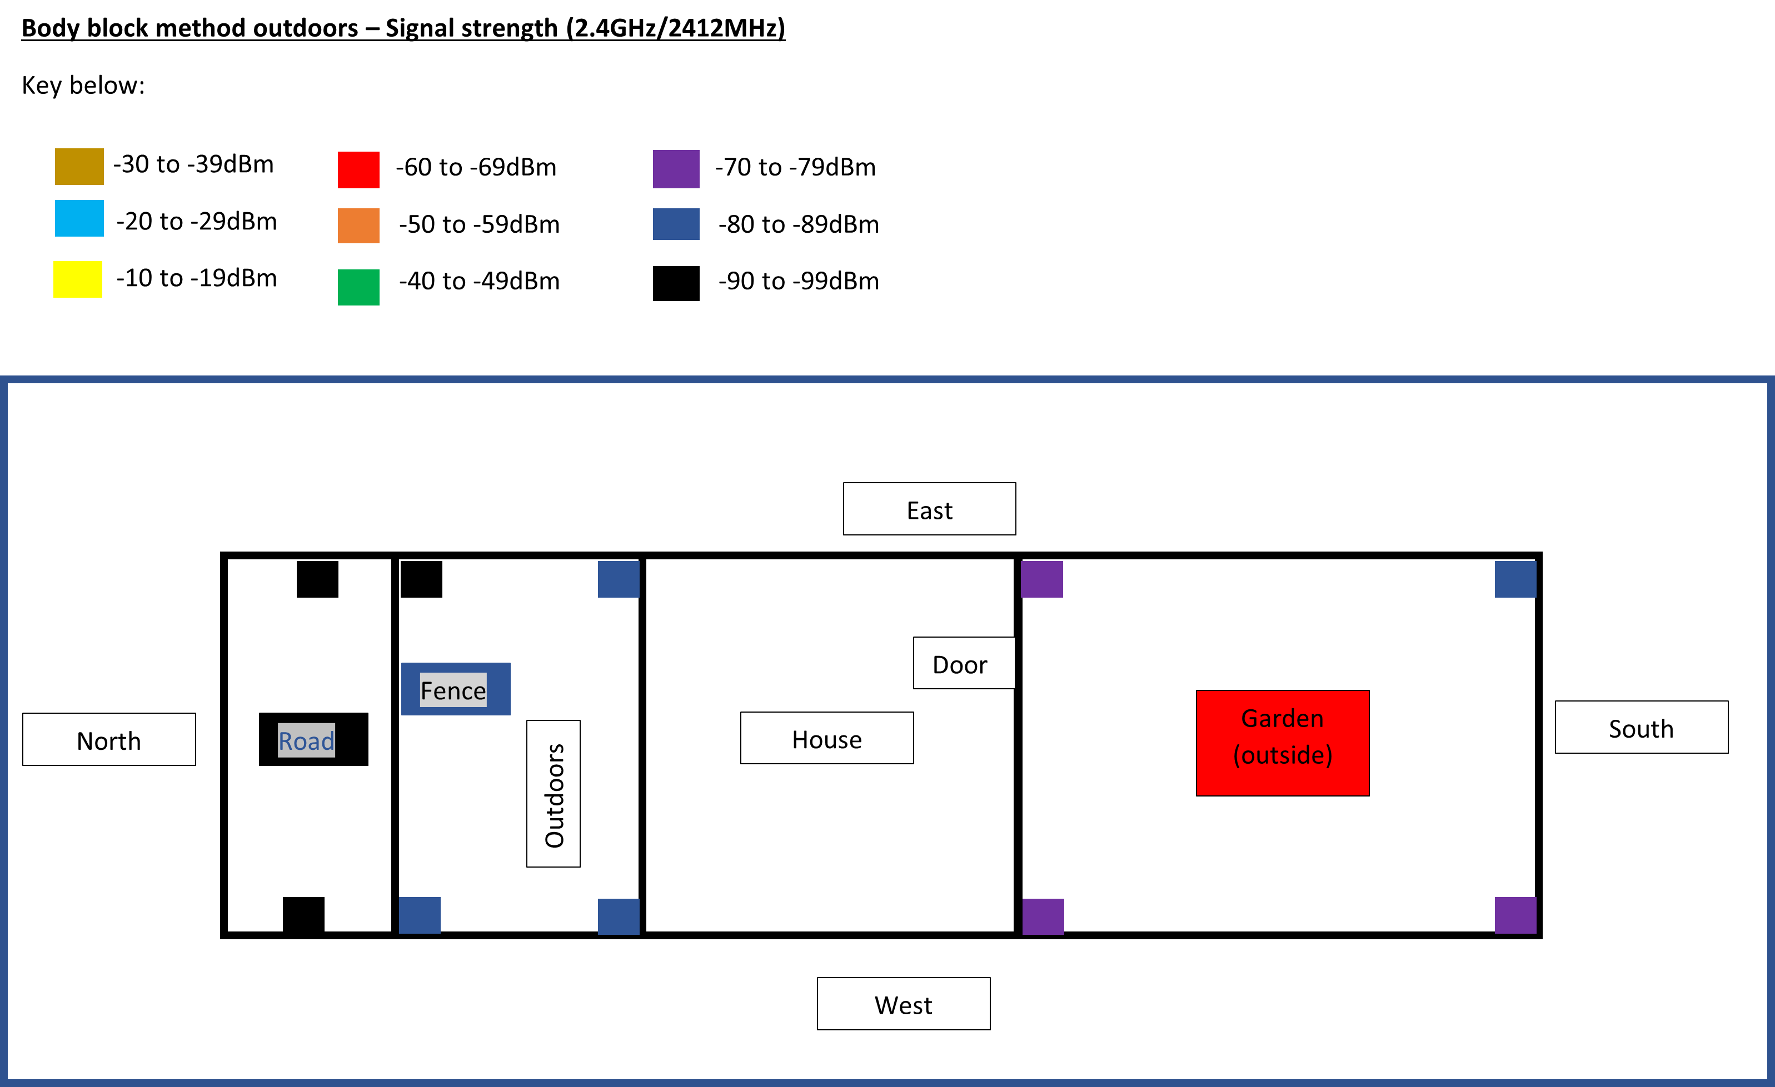
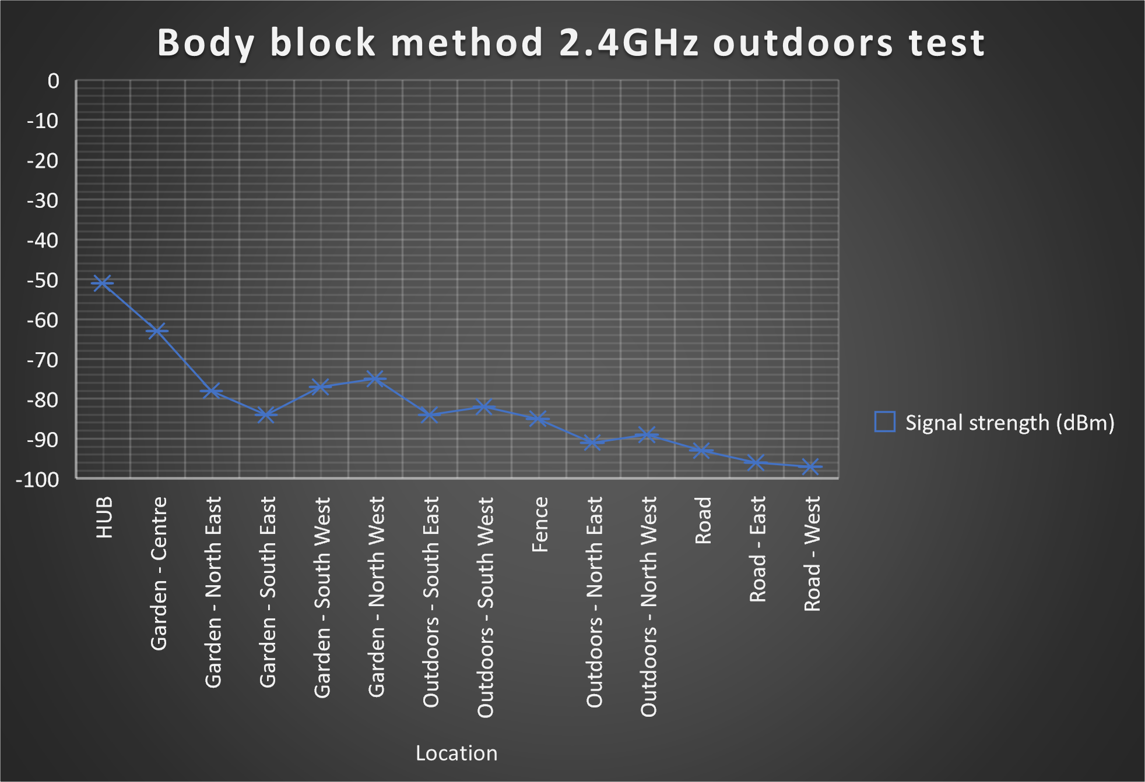
Experiment 7
Body block method 2.4GHz outdoors testing
Signal declined as the device moved further away from the hub
Body block method weakened the signal

Slide 12
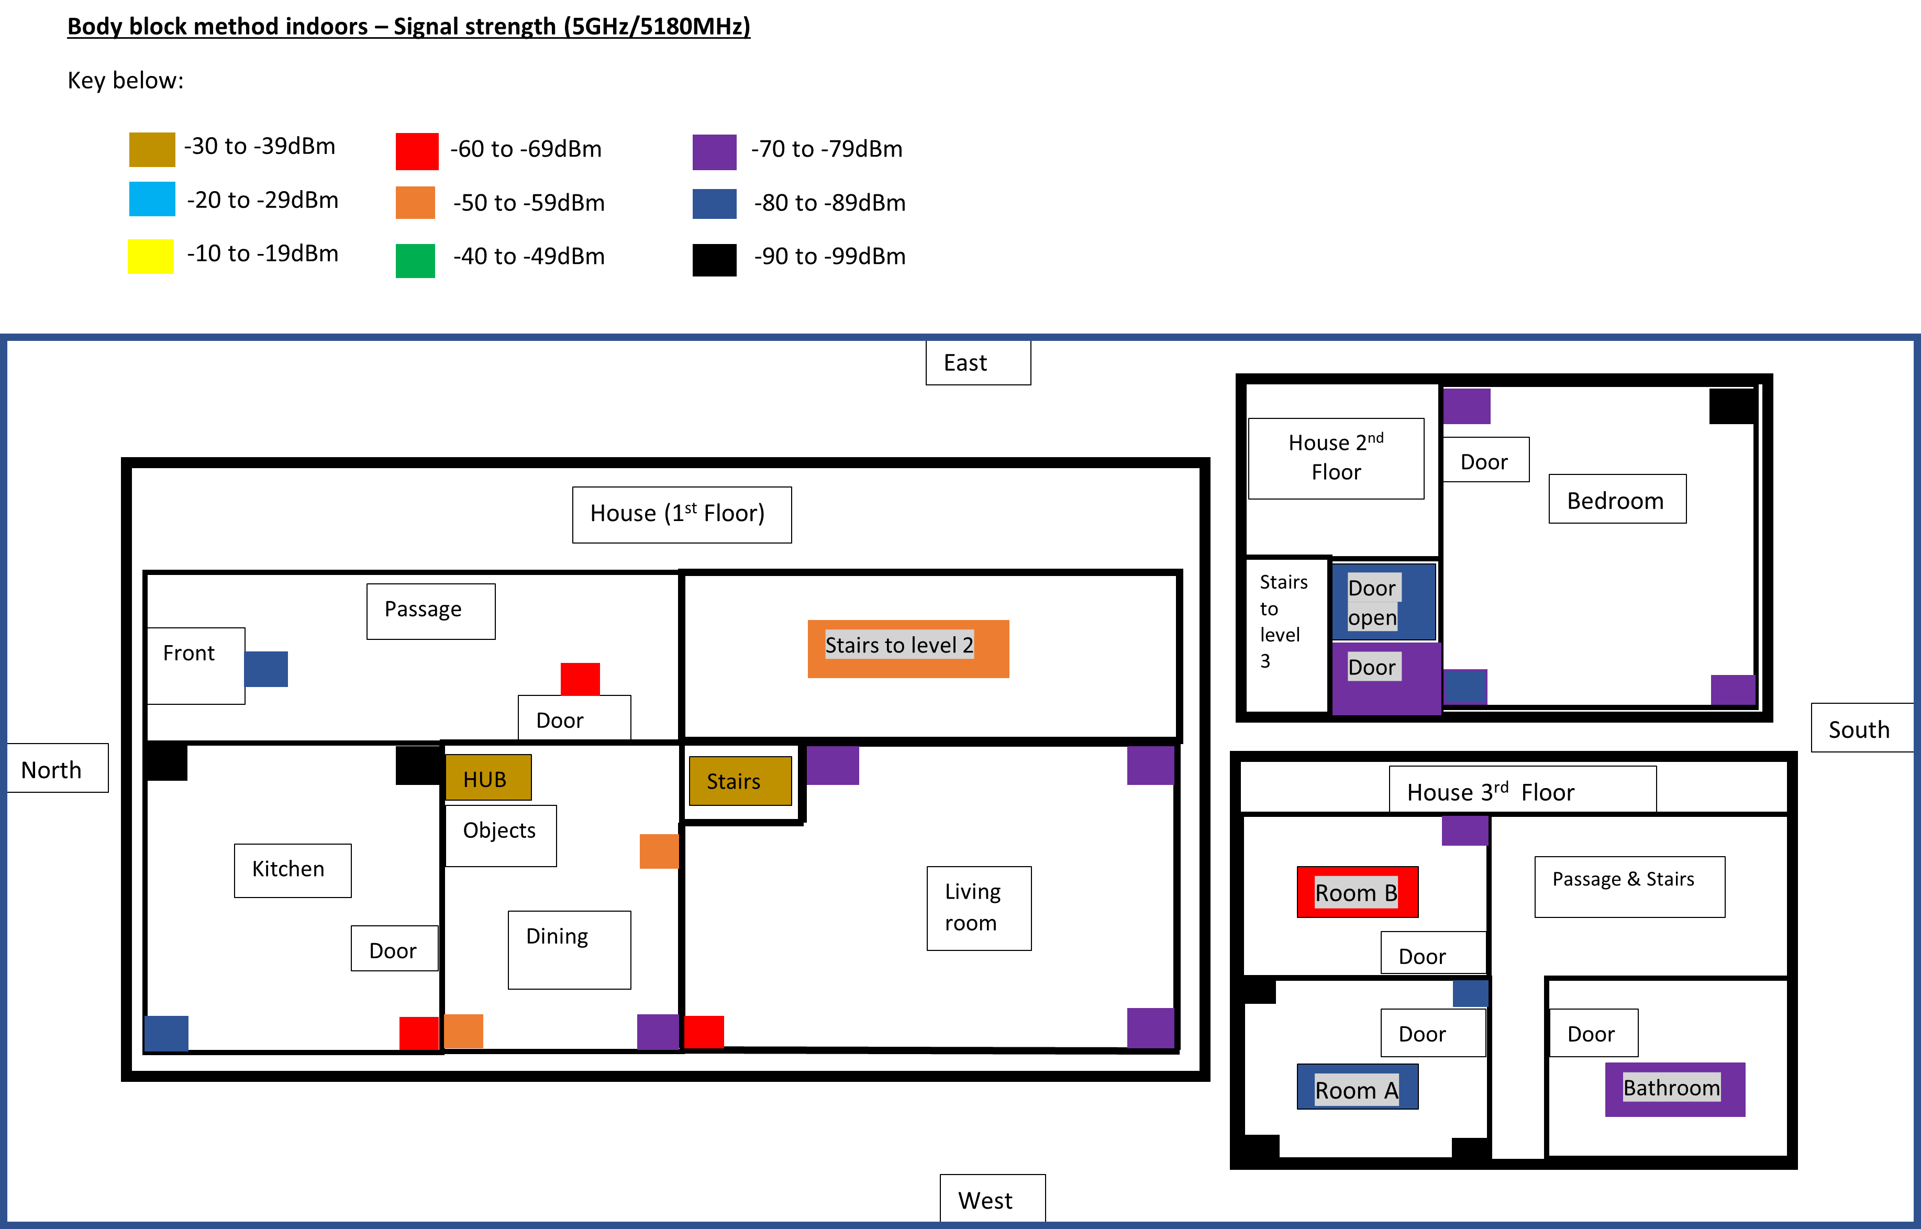
Experiment 8
Body block method 5GHz indoors testing

Slide 13
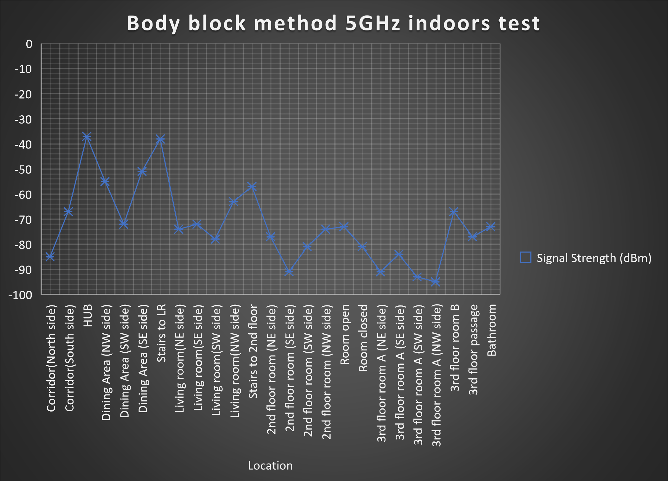
Experiment 8 - Results
Signal strength is very strong when close to the HUB

Slide 14

Achievements
Completed WiFi testing for 2.4GHz & 5GHz
Bought and used an SDR
Body block method testing
Completed final report
Background research completed
CE301 deadlines completed & submitted on time

Slide 15

Setbacks
Not being able to use a drone
Not being able to comeback to my university accommodation in 2nd Term
Lack of equipment
Time constraints
The pandemic, the university closing the Hardware lab and everything being done through zoom/online
Not having the equipment to test for 5.8GHz signals – (Had to settle for 5GHz testing)

Slide 16


Project planning
JIRA – Used to manage tasks and project
GitLab – Used for technical documentation

Slide 17
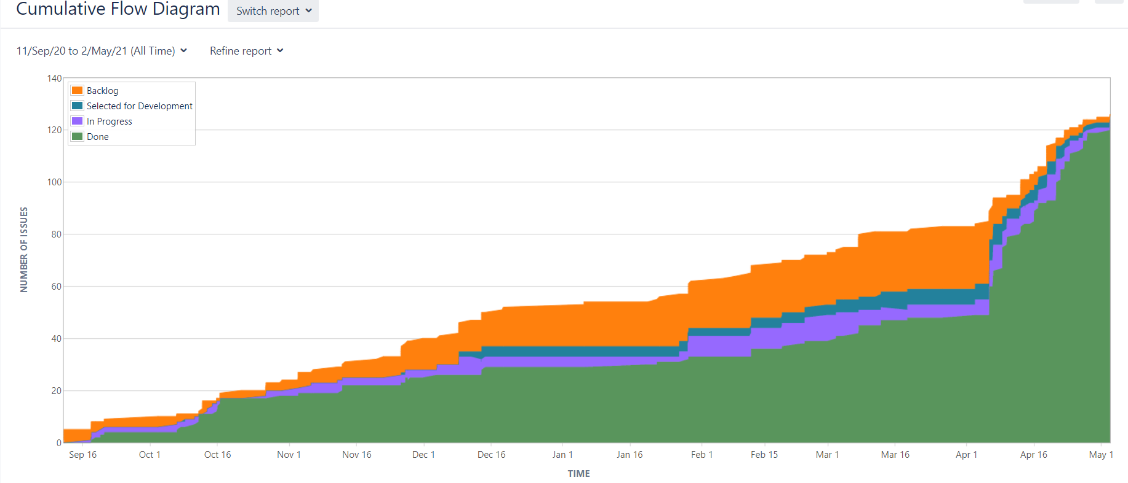
Project planning record graph

Slide 18

Conclusions
There is no simple/perfect method for countering drones yet
However a combination of methods can be used for countering drones effectively

Slide 19
Questions ???

